Slide 1
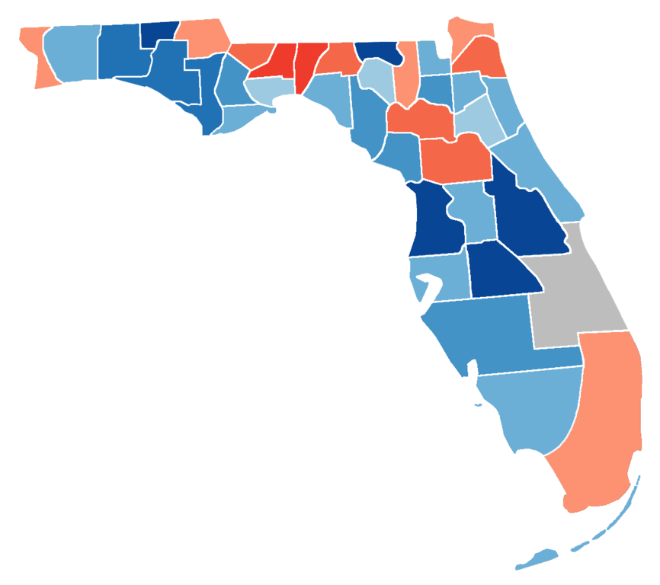

Evaluating the Pricing Strategy of Airbnb in Florida, 2022
Team 31, Oct 2022

Slide 2

Business Understanding
Key Questions
Is there seasonality of price and room availability?
What features of a listing impact its price?
How do positive and negative reviews drive prices?
Goal
Predict the price of each Airbnb to help host get more revenue
Provide price range for customer having preference on certain features
Provide Airbnb suggestions on how to manage the quality and quantity of reviews

Slide 3
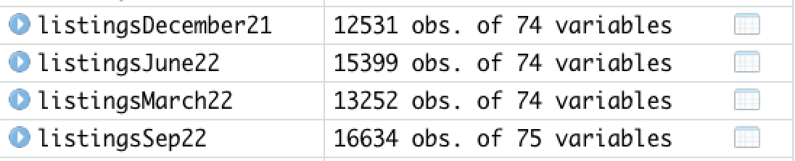
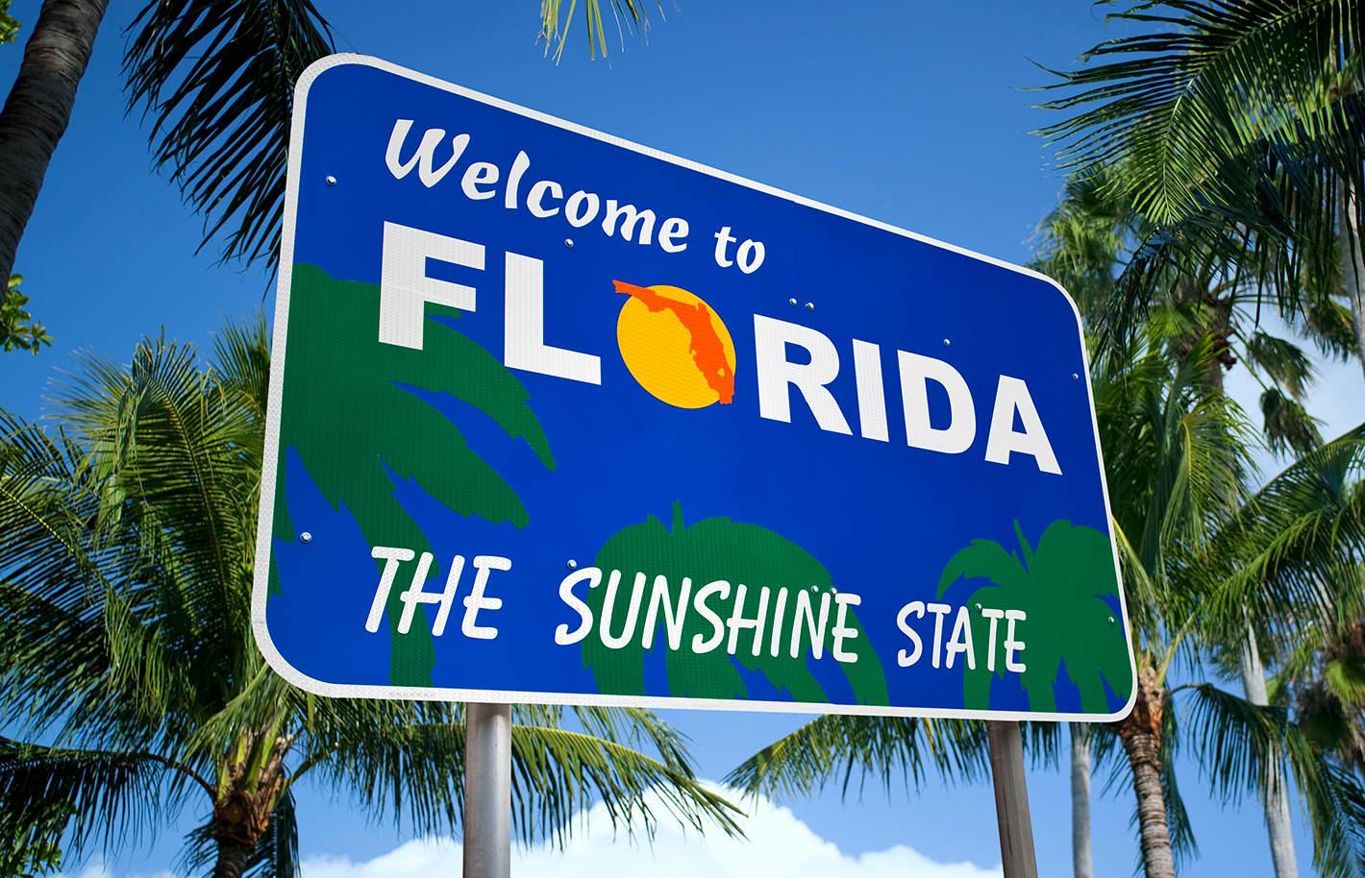
Data Preparation
Source: Inside Airbnb
Calendar: including listing id, price and availability for that day
Listings: attributes of listing and hosts, and average review scores of each Airbnb
Reviews: unique id for each reviewer and detailed comments
Combine four quarters from Inside Airbnb, September 2022, June 2022, March 2022, December 2021 to a brand-new one-year dataset for all the three files prepared for data cleaning.
Merge listings with calendar to get a comprehensive dataset for further modeling.

Slide 4
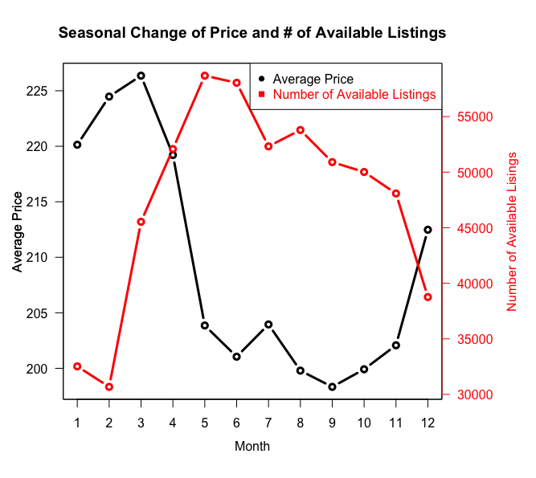
Finding: Airbnb price reaches highest from Dec. to Mar.
Insight: Charge higher price during “busy” period will not lose large customer bases
Price is the highest in March
# of available listings is the lowest in February
Notes:
The highest prices appear from December to March, from winter break to spring break.
The number of listings is the lowest from December to February, while it shows a huge increase from February to March, demonstrating that even if the price is extremely high in March, there’s still a few people traveling to Florida in March

Slide 5
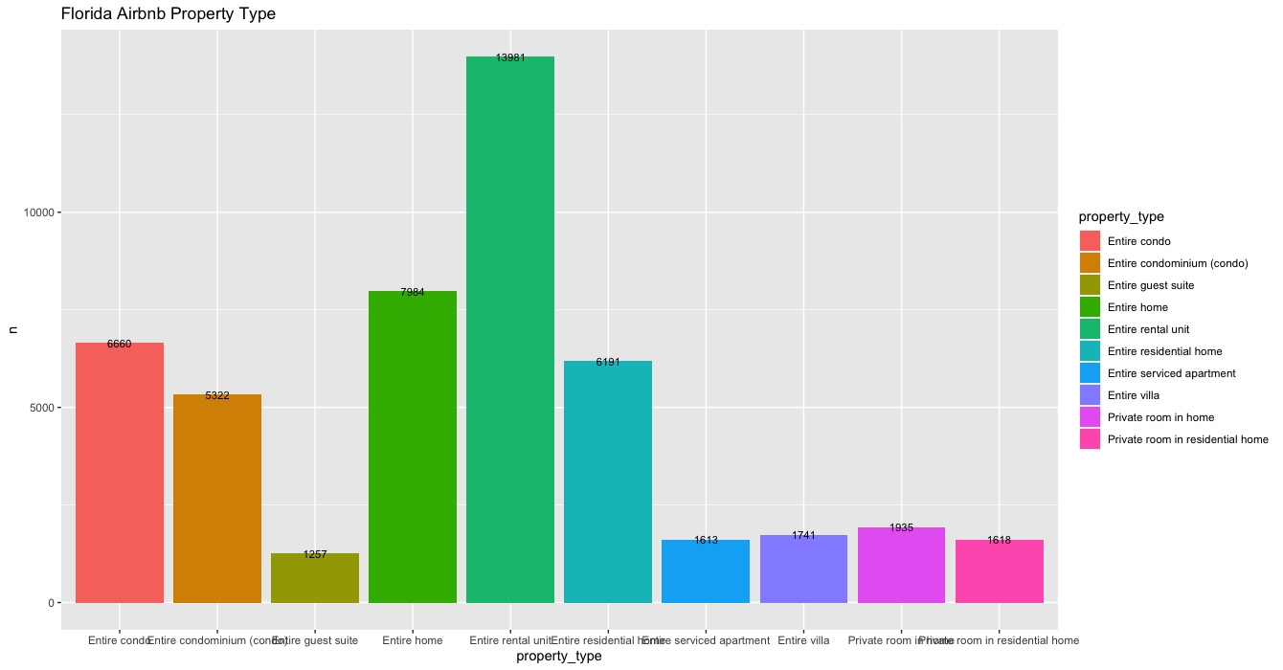
Entire home/apt accounts for the majority of Airbnb Property Type

Slide 6
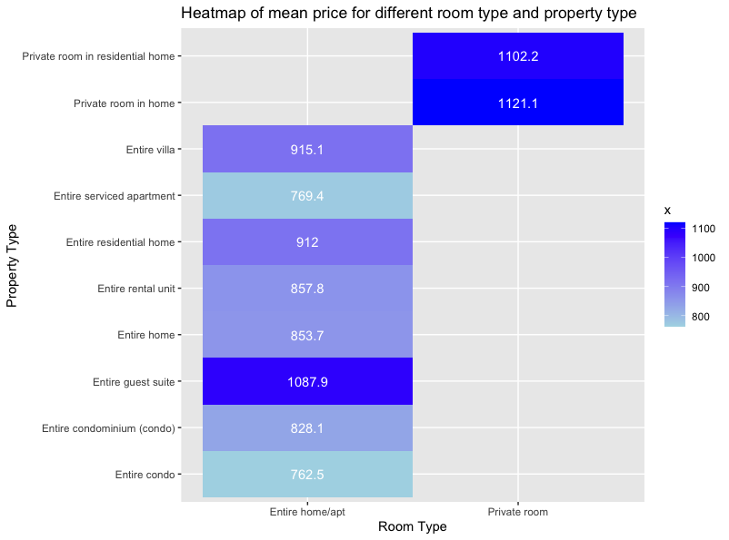
Private room in home has the highest price

Slide 7
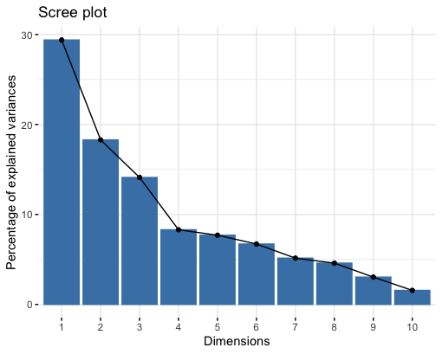
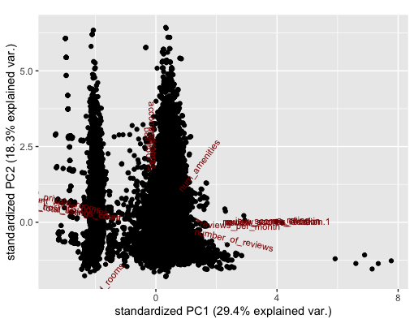
PCA on Listing
PC1: Higher review scores, especially on check-in and location
PC2: Listings that have more bedrooms and accommodate more people.
PC3: Listings belong to hosts with fewer homes
PC4: Listings with fewer reviews on average

Slide 8
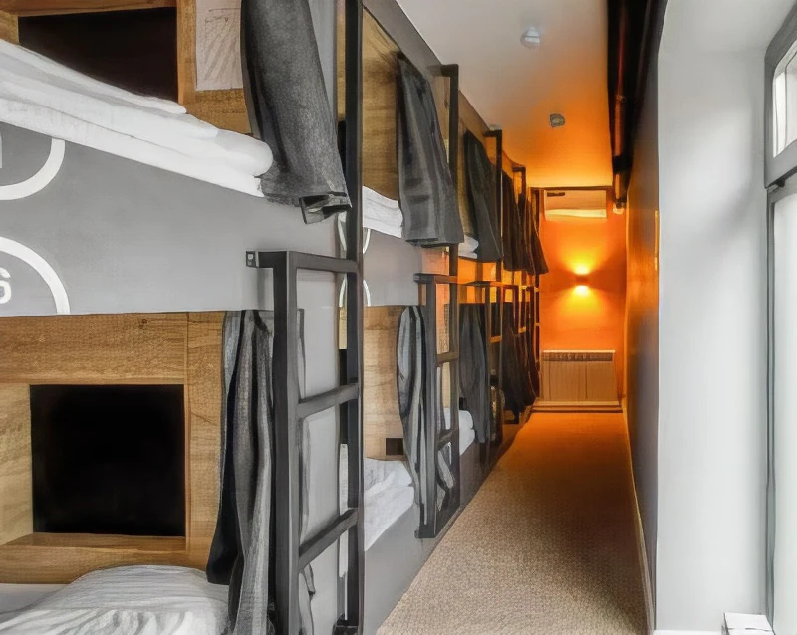
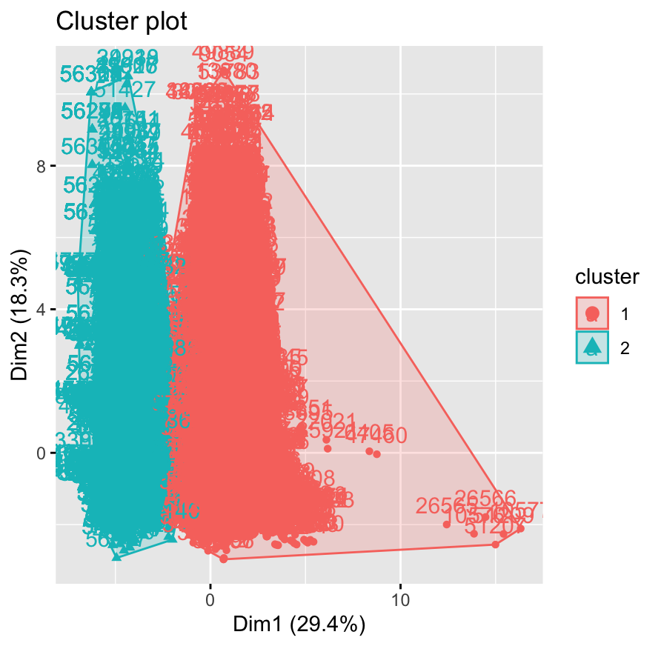

K-means on Listing
Cluster 1: (Shared Rooms) Listings with more bedrooms, bathrooms and accommodate more people, fewer amenities -> fewer reviews, lower overall ratings
Cluster 2: (Entire homes) Listings with fewer bedrooms, bathrooms, more amenities -> more reviews and more positive reviews.

Slide 9
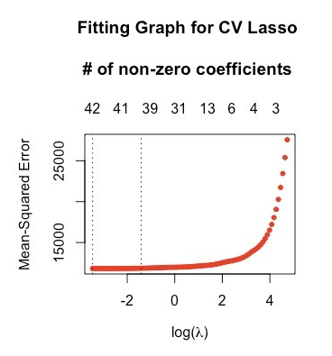
Linear, Stepwise Selection, Lasso, Post Lasso
Linear
Regression 1 <- lm(price ~., data = listing)
Stepwise Selection
(forward and backward)
Regression 2 <- ols_step_both_p(Regression 1, pent = 0.05, prem = 0.05)
Lasso and Post-Lasso
cv_model <- cv.glmnet (listing$x, listing$price, alpha = 1)
#find optimal lambda value that minimizes test MSE
best_lambda <- cv_model$lambda.min
#find coefficients of best model
lasso.model <- glmnet(x,y,alpha=1, lambda = cv.model$lambda.min )

Slide 10
Model Evaluation
 | Multiple Linear Reg | Stepwise Linear Reg | Lasso | Post Lasso | Random Forest Reg | Classification Tree | Logistic Reg (available = 0/1)
R2 | 0.04252 | 0.58 | 0.863 | 0.859 | -0.446 | 0.225 | 0.028
OOS R2 | 0.04307 | -14.53 | 0.570 | 0.571 | -0.171 | — | —
RMSE-Train | — | — | — | — | 182.086 | — | —
RMSE-Test | — | — | — | — | 304.549 | — | —
TPR/FPR | — | — | — | — | — | TPR=0.721 FPR=0.725 | TPR=0.82 FPR=0.69

Slide 11
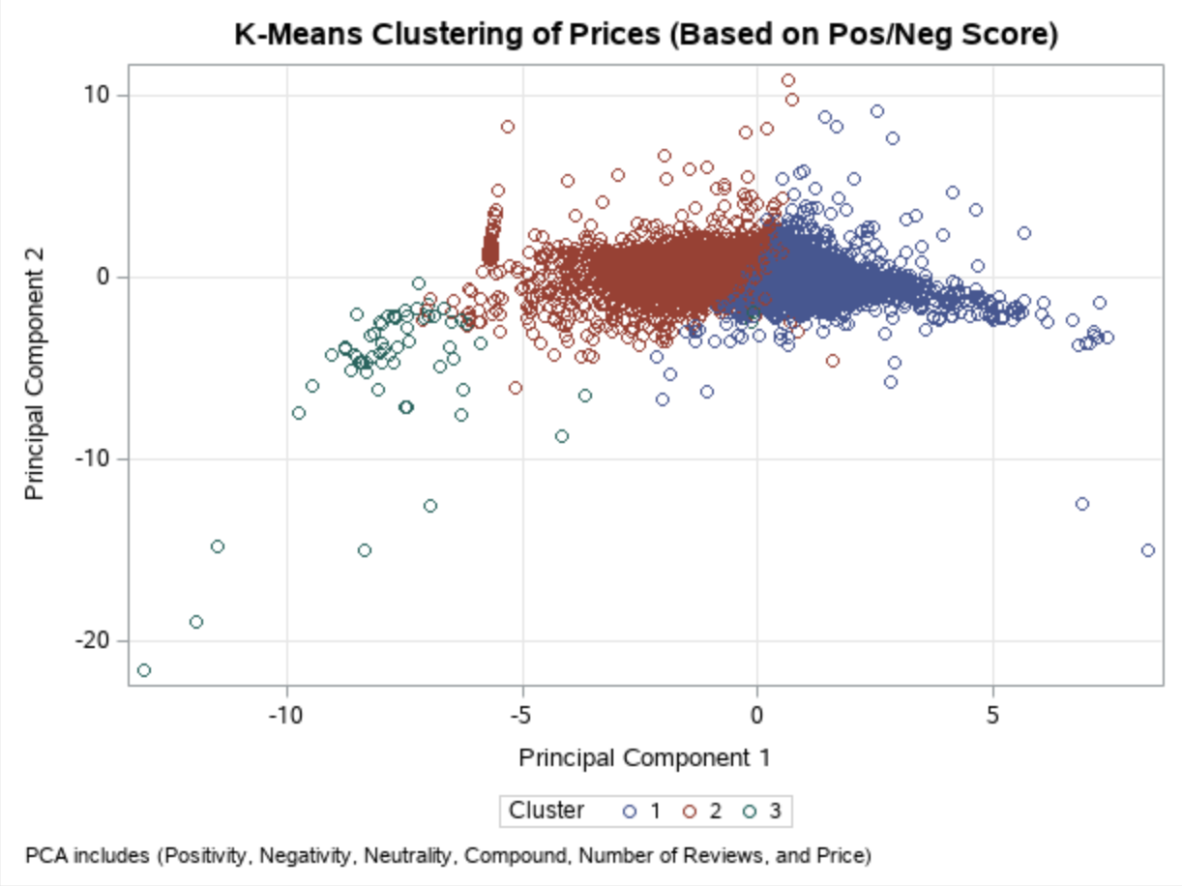
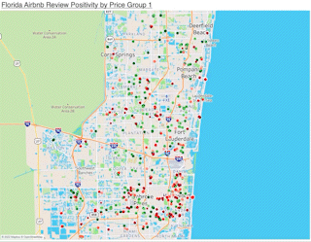
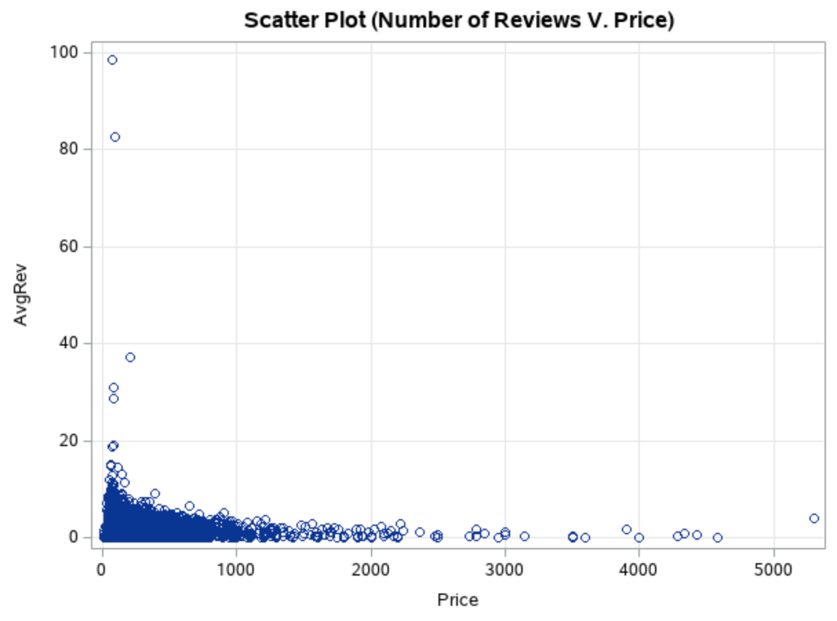
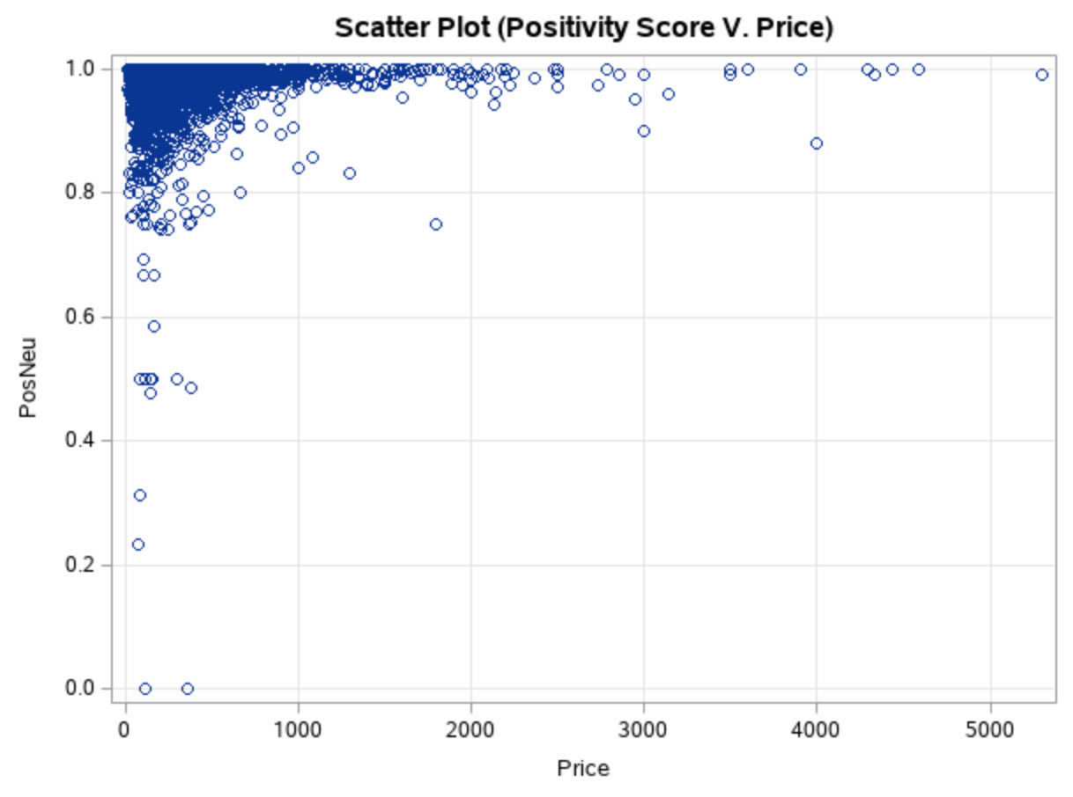
Reviews reveal bleak correlation between price/positivity and price/number-of-reviews
Clusters drawn with 2 PCAs reveal that there are three clusters
No relation between price v. positivity and price v. number of reviews

Slide 12




Deployment
Host Management & Onboarding System
Airbnb Partner Compliance System
Airbnb Application (Area Map)
Airbnb Application (Filtering)
Risk(s) | Mitigation
Scalability and Accuracy | Train model with more Airbnb data and include advanced ML models

Slide 13
Implications / Summary
In this presentation, we went over:
What can be improved in Airbnb’s host management systems (Prices, Features, Likeability)
How we can improve it (Studying price v. occupancy, price v. amenities, price v. reviews)
The models we used for the purpose (PCA, K-Means, Regression, Random Forest, NLP, etc.)
How we will deploy it (Host Management, Application, Compliance Systems)

